Slide 1
Airbnb
Dhanashree Mane
Faliha Zikra
Fuisim Yap
Sanya Purwar
Xiao Zhang

Slide 2

Background
Lodging industry – competitive
Customers look for attributes- Physical/ Non-Physical
New section- Experiences
Events, Concerts, Tours, Meetups etc

Slide 3


Business Scenario
As VP of Experiences, understand the impact of bring in new experiences to cities.
Questions like?
Which months are more busy to host events?
Which neighborhoods can we target to have these events?
Want to add value to the hosts/ customer experience
If adding experiences to a city will increase the review ratings
Will people choose a city based on experiences
Use these findings to bring experiences to not-so famous cities

Slide 4
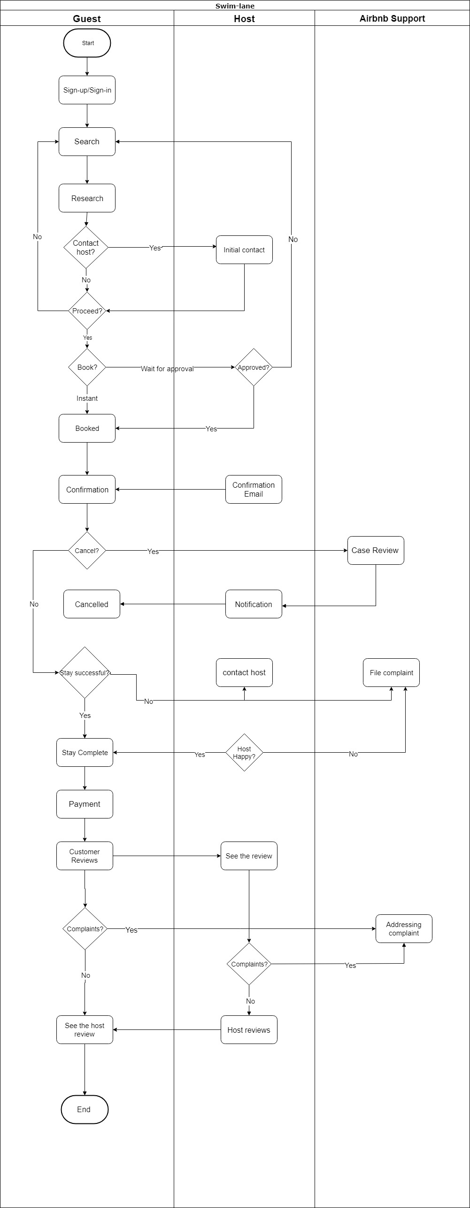
Swimlane

Slide 5
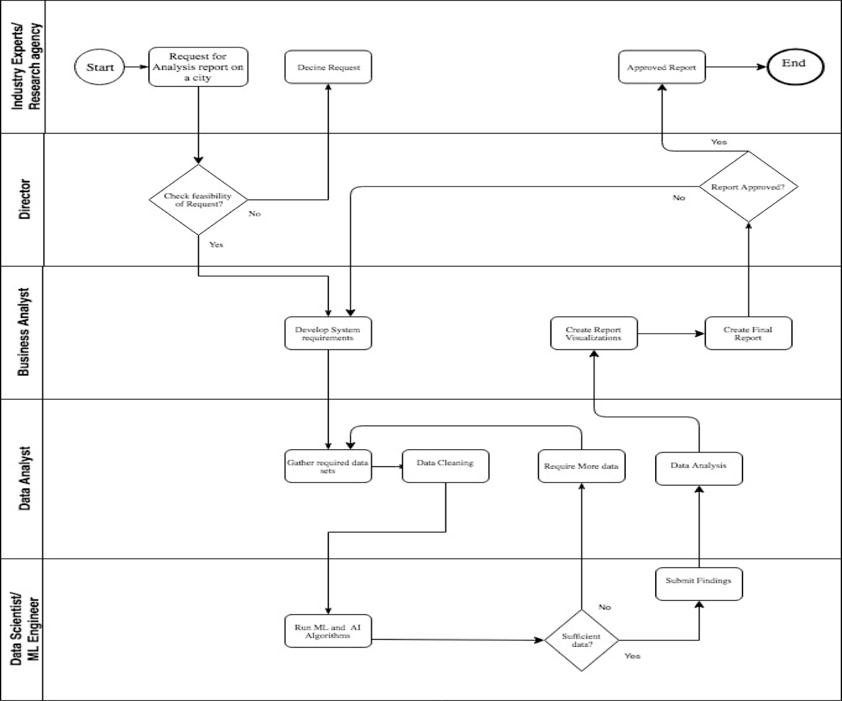
Swimlane

Slide 6
Data Architecture
WHAT | What business processes will be supported? | Revenue Growth, Property Investments, Customer Experience Improvement
 | What type of analytics to be performed? | Trend analysis, Correlation analysis, Future prediction
 | What decisions to be taken? | Correlation changes Future prediction Strategy?
WHO | Who will benefit? | Customers, Airbnb, Stakeholders
WHERE | Where is the data now? | Excel and CSV files, with inconsistent granularities
 | Where will it be cleansed and refined? | Microsoft Excel (filtered)
 | Where will it be transformed and segregated in data marts? | Pentaho
 | Where will analytics be consumed? | Tableau
WHY | Why will dashboards be built? | Provide a visual representation Draw conclusions Useful recommendations

Slide 7
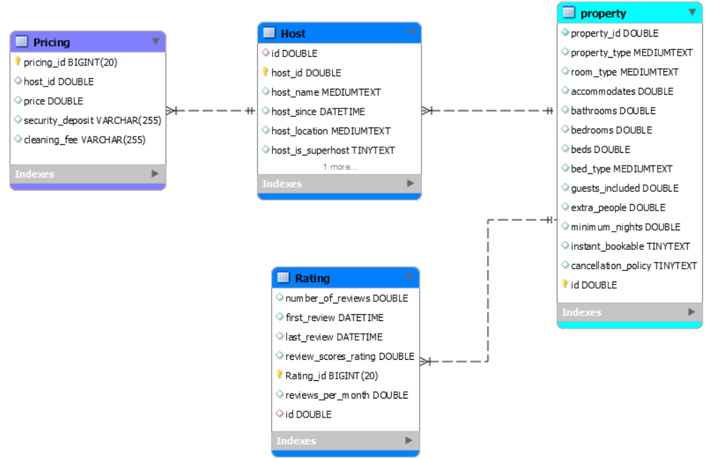
Data Model
Property
Host
Rating
Pricing

Slide 8
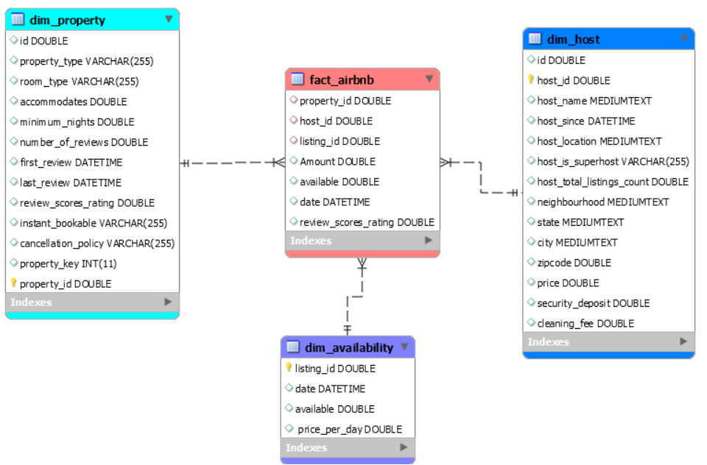
Dimension Model
Facts:
Available
Amount
Review_scores_rating
Dimensions:
Dim_property
Dim_host
Dim_availability
Keys:
Id
Host_id
Listing_id

Slide 9
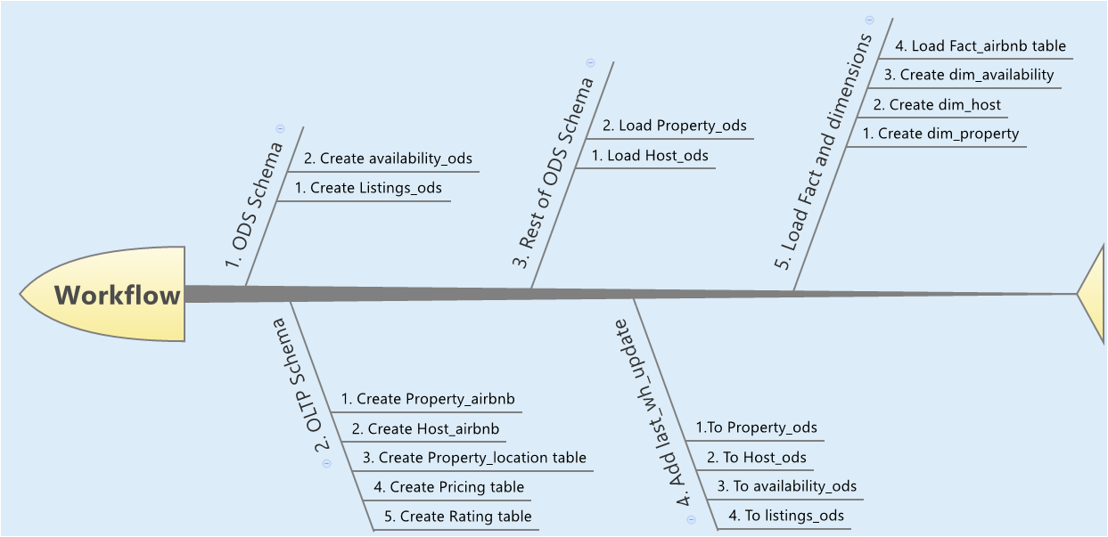
ETL Design Overview

Slide 10
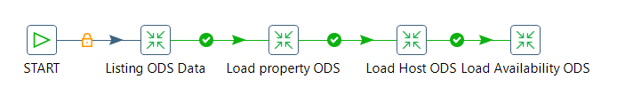
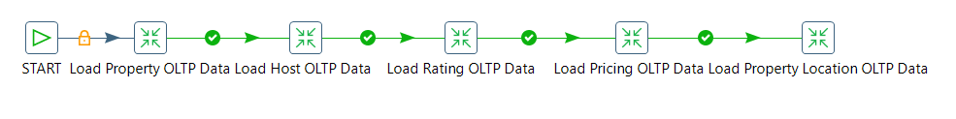
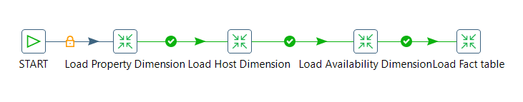
ETL Mappings

Slide 11

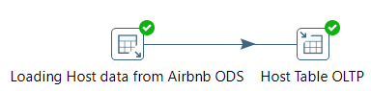
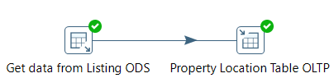

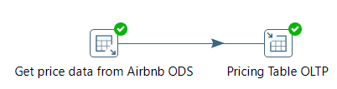
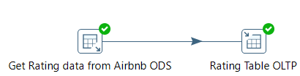
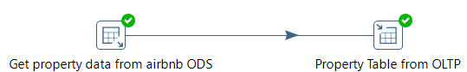
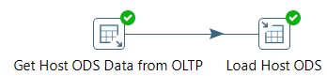

Slide 12
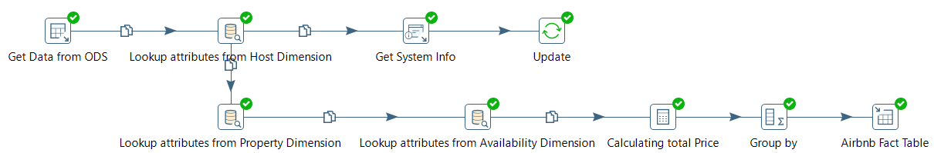

Slide 13
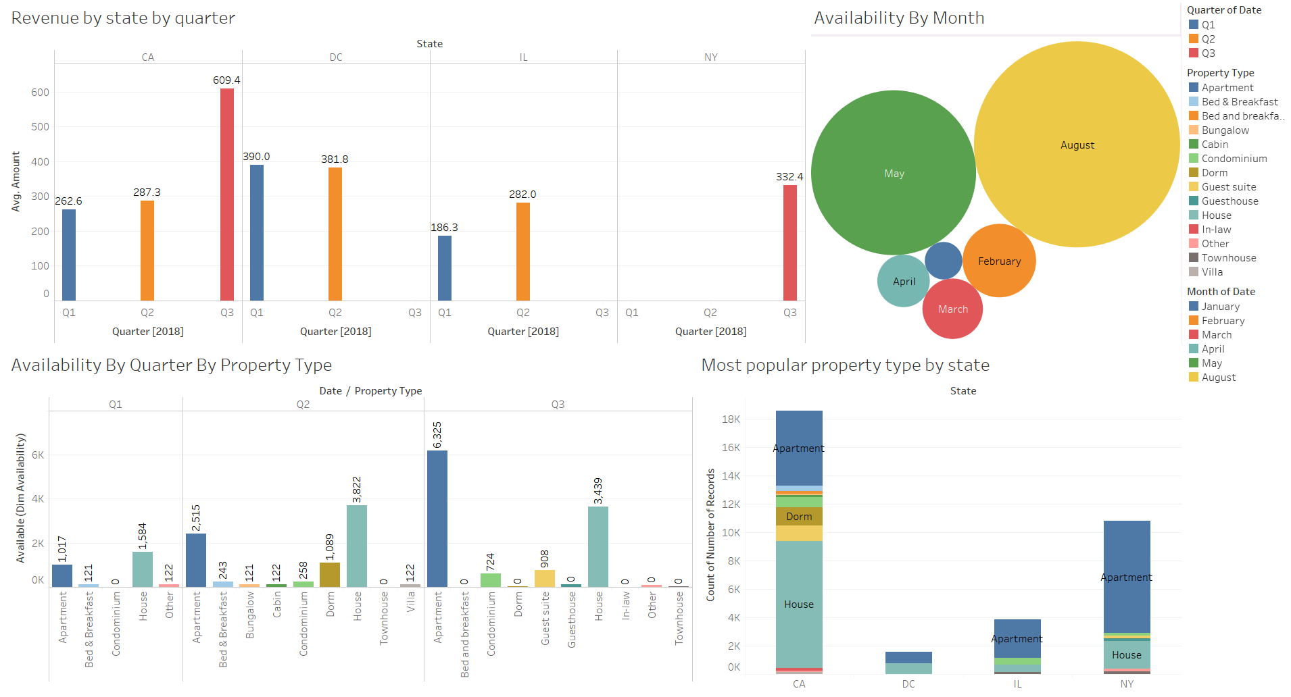
Descriptive Dashboard 1

Slide 14
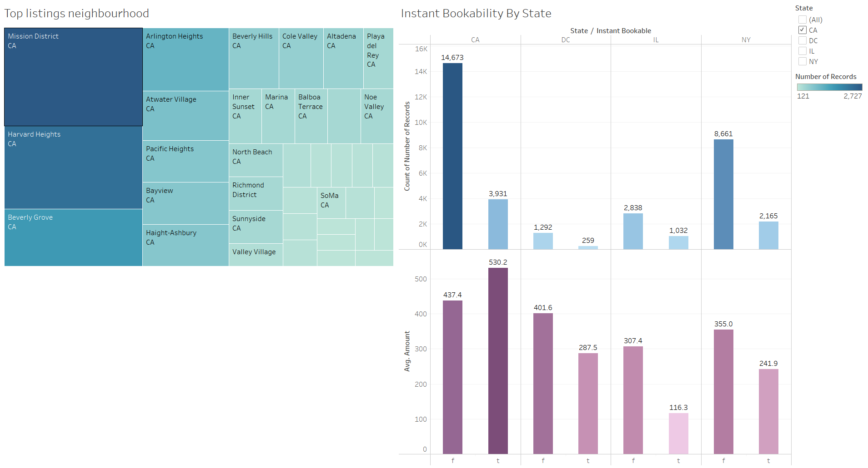
Descriptive Dashboard 2

Slide 15
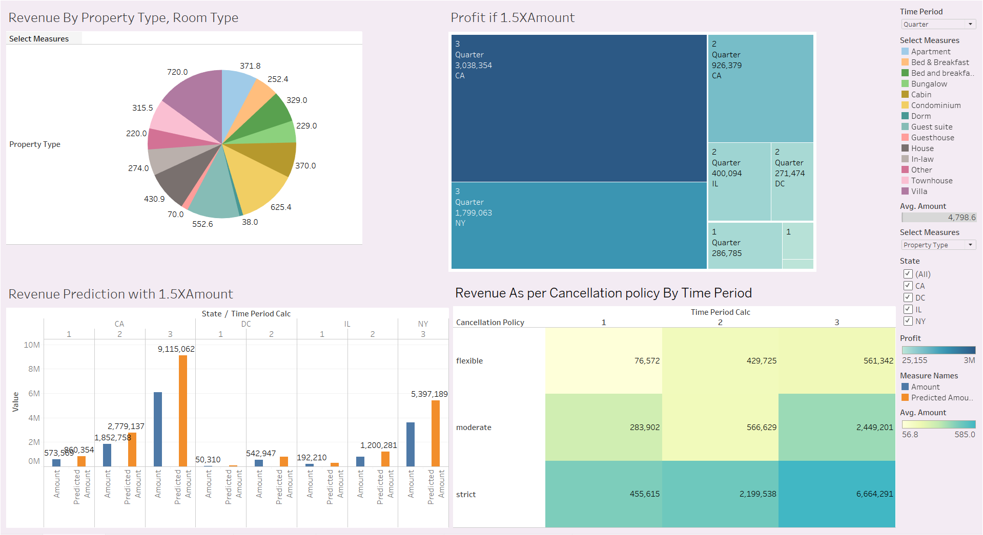
Predictive Dashboards

Slide 16

Key Learnings
Importance of domain selection
Fit our goals and is within scope
Data Quality
Data Gathering and Cleansing
Data Modelling
Data Integration
Scheduling and Managing tasks

Slide 17


